Slide 1
Autoencoder Reconstruction Ratio
Bryan Lim
19 May 2020
Reference:
Lim, Bryan and Zohren, Stefan and Roberts, Stephen, Detecting Changes in Asset Co-Movement Using the Autoencoder Reconstruction Ratio (January 23, 2020).
Available at SSRN: https://ssrn.com/abstract=3524654

Slide 2
Motivations
The time-varying nature of asset correlations has widely been documented in academic literature
Portfolio Construction - Short-term changes in asset correlations have been linked to spikes in market volatility
Systemic Risk – Tightly coupled markets (as measured by increased co-movement between sector returns) a sign of market fragility
Project Goals
Real-time detection of changes in asset co-movements
Make use of intraday data for timely measurements – e.g. in a similar fashion to realized volatility measures

Slide 3
Detecting Changes in Asset Co-movement
Modelling The Covariance Matrix
Gaussian model for returns
Two common approaches
Factor-based Methods
Measure the extent to which returns are driven by common factors
Typical uses PCA for dimensionality reduction
Model time-varying dynamics
Limitations:
Implicit Gaussian assumptions remain
Estimate covariance with a moving window (and/or intraday data)
Limitations
Existing approaches applied only to daily data
Pairwise correlations hard to condense into single metric
Single metric for co-movement changes
Naïve model specification can lead to spurious effects
Suitability of Gaussian assumptions (?)

Slide 4
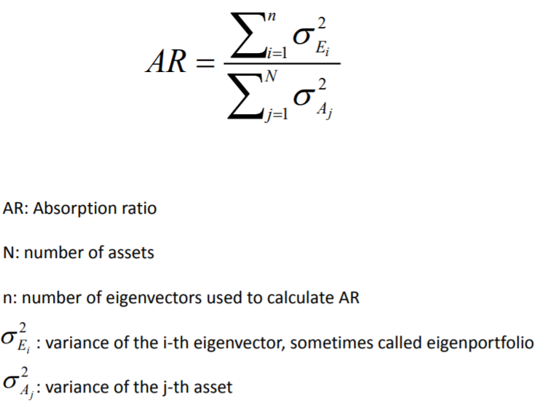

Absorption Ratio
Equation:
In words:
i.e. Fraction of variance explained
$$AR=\frac{Variance of PCA factors}{Total variance of returns vect.}$$

Slide 5

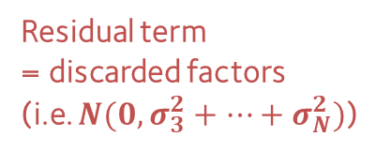
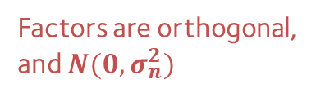
Recasting the Absorption Ratio
PCA Linear Factor Model (assume 0 mean)
Dimensionality Reduction
Linear PCA Factors
N-dimensional Returns Vector
$$r_{t}=f\left(1, t\right)+f\left(2,t\right)+f(3,t)…+f(N,t)$$
Factors are orthogonal, and $N(0, σ_{n}^{2})$
Factors Selected
$$r_{t}=f\left(1, t\right)+f\left(2,t\right)+ε(t)$$
Residual term
= discarded factors
(i.e. $N(0, σ_{3}^{2}+…+σ_{N}^{2})$)
Absorption ratio fraction of variance here

Slide 6


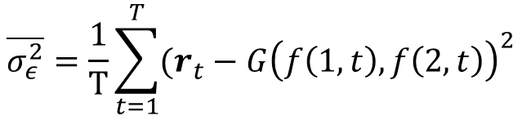
Recasting the Absorption Ratio
For Non-linear Factor Models
Estimating Residual Variance
Residual $N(0, σ_{ε}^{2})$
Factors Selected
$$r_{t}=G(f\left(1, t\right),f\left(2,t\right))+ε(t)$$
Nonlinear Transformation
Reconstruction Error
$$\overline{σ_{ε}^{2}}=\frac{1}{T}\sum_{t=1}^{T}{{(r_{t}−G\left(f\left(1, t\right),f\left(2,t\right)\right)}^{2}}$$

Slide 7
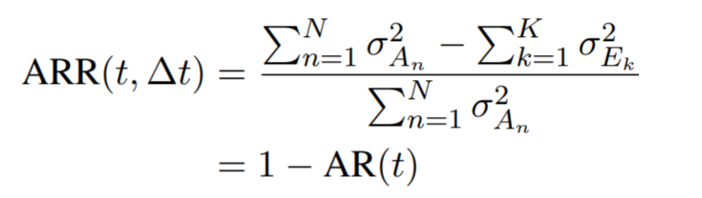
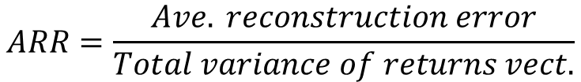
Autoencoder Reconstruction Ratio (ARR)
In words:
Relationship to Absorption Ratio
$$ARR=\frac{Ave. reconstruction error}{Total variance of returns vect.}$$

Slide 8
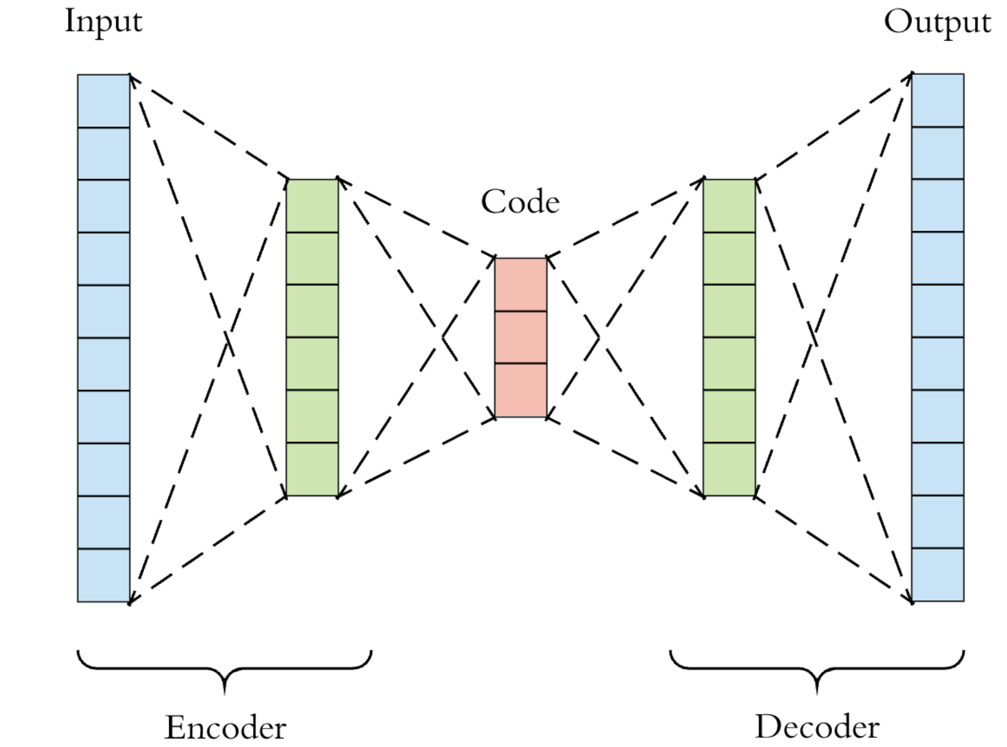

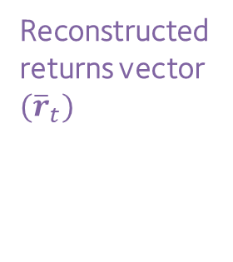
Basic Autoencoder
Returns vector $(r_{t})$
Reconstructed returns vector ${(\overline{r}}_{t})$
Exogenous Inputs
e.g. time-of-day
Low-dimensional latent space
(2-layered Neural Network)
(2-layered Neural Network)
Image Src: https://towardsdatascience.com/generating-images-with-autoencoders-77fd3a8dd368

Slide 9
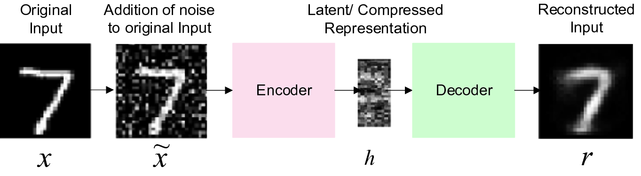
Sparse Denoising Autoencoders
Additional Regularisation
Input Noise (e.g. dropout, or white noise)
L1 regulariser on latent codes
Image Src: Pawar K., Attar V.Z. (2020) Assessment of Autoencoder Architectures for Data Representation. In: Deep Learning: Concepts and Architectures. Studies in Computational Intelligence, vol 866. Springer, Cham

Slide 10
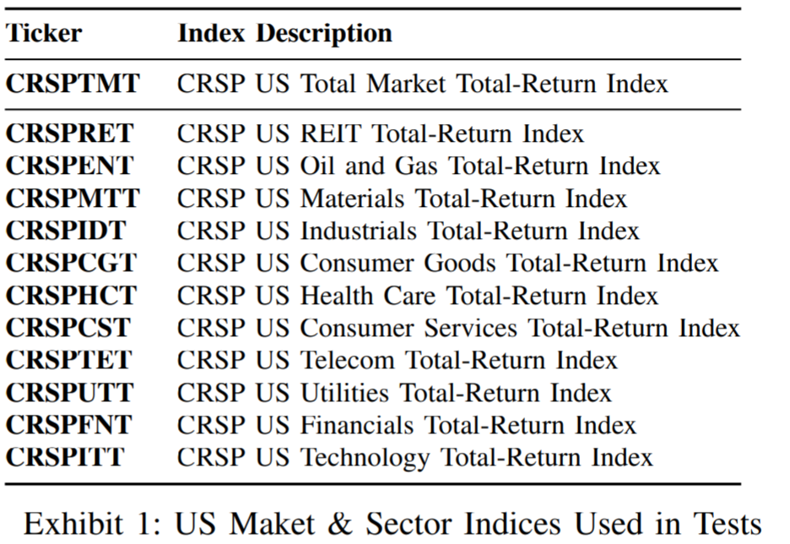
Use Case - Systemic Risk
Test Details
CRSP Market & sector indices from WRDS
Central idea:
Detect tight coupling in sector indices
To forecast risk for CRSP US Total Market
Autoencoder Specification
2-dimensional latent space (1/5 of input dimension)
In-sample data
Training (2013-2015), validation (2015-2016)
Out-of-sample data (2016 onwards)
Forecast Risk
Compute ARR

Slide 11
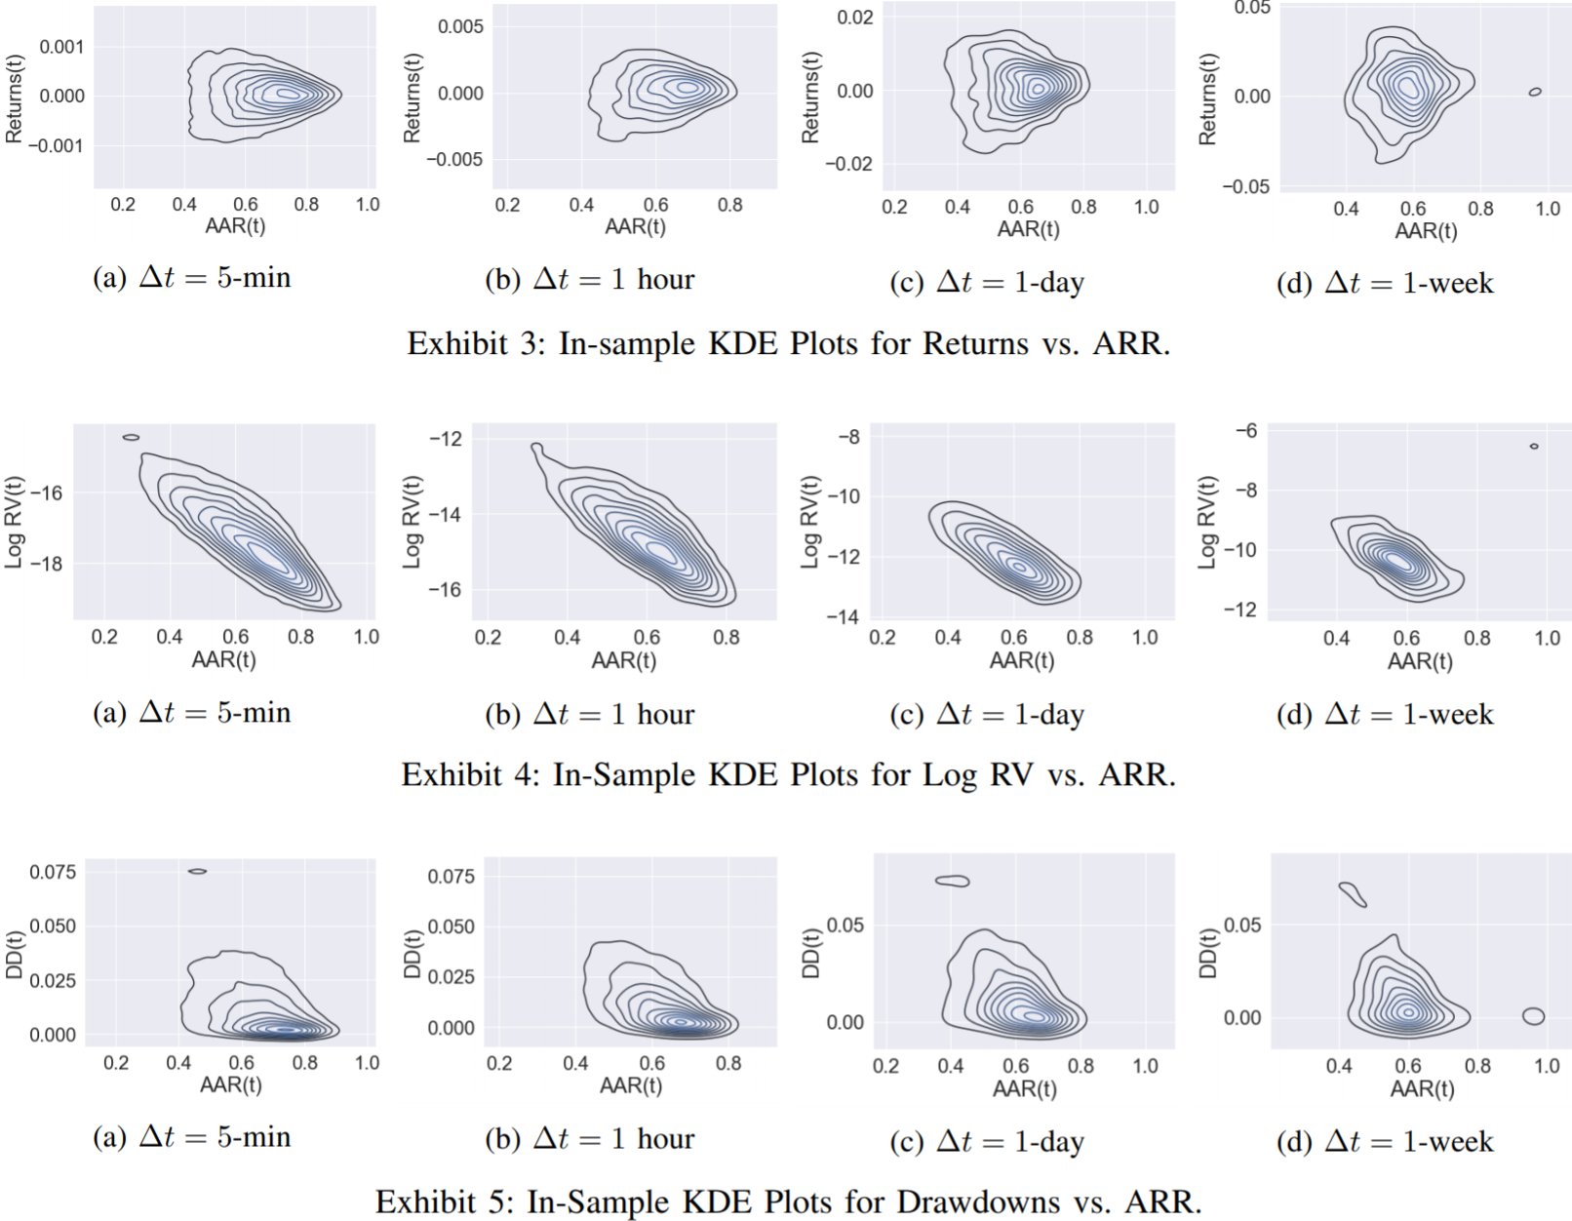
Preliminary Data Analysis

Slide 12
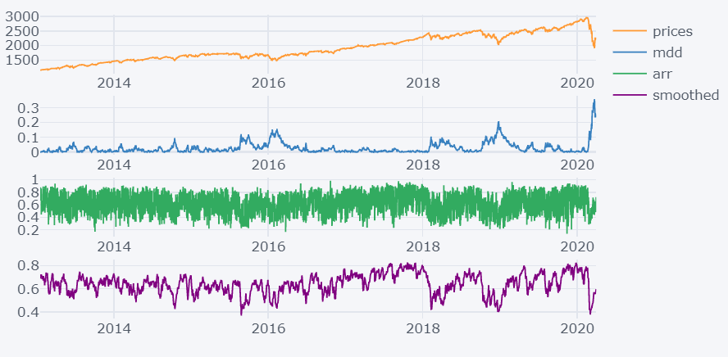

Visualising ARR
In Sample
Out of Sample
CRSP US Total Market
Drawdowns
Raw 5-min ARR
Smoothed with 1-day EWMA

Slide 13
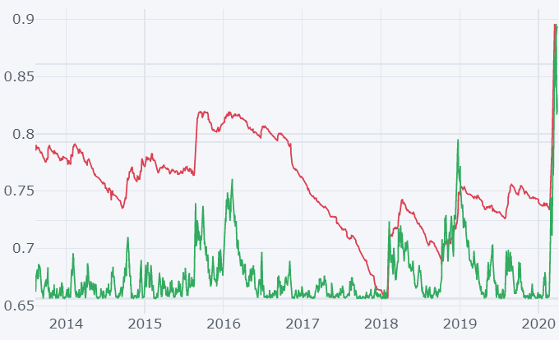
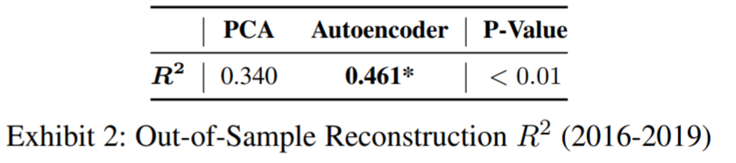
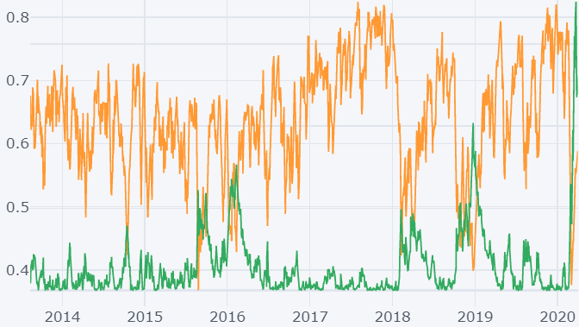
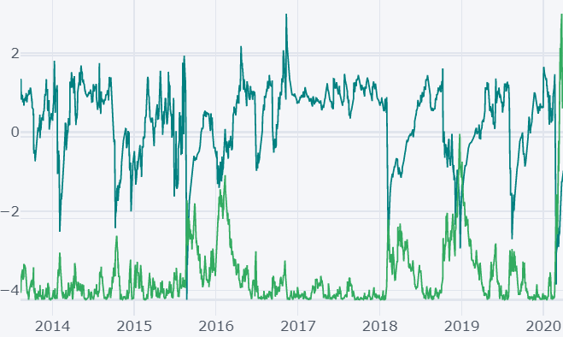
ARR vs Absorption Ratio
Absorption Ratio (1 y EWM) vs Drawdowns
Smoothed 5min ARR vs Drawdowns
Neg. Z-Score (2o-day EWM) vs Drawdowns

Slide 14
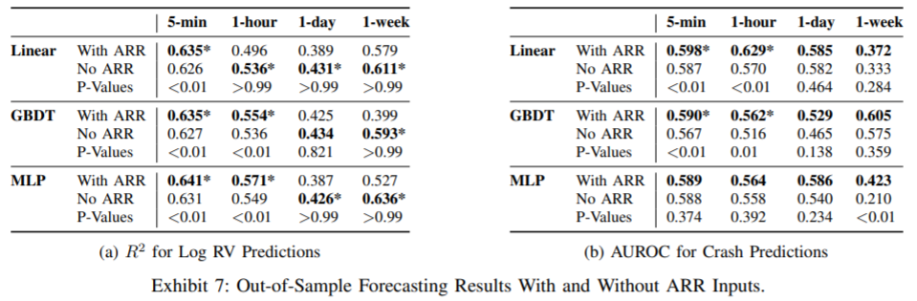
Incorporating ARRs in Forecasting Models
Risk metrics (i.e. past log RV or crash labels) and ARR used as inputs
Crashes defined to be when returns z-score <-1.5
Key results
ARR improves short term volatility forecasting (i.e. 5-min and 1-hour) and crash prediction models

